Slide 1


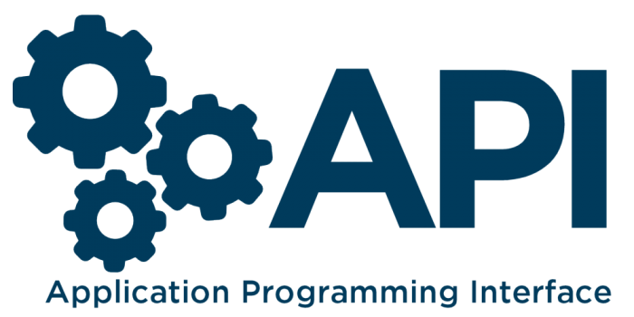
Understanding the API Basics
What is API, API Testing & REST API
By Promode

Slide 2
In this Lecture
What is an API ?
What is REST ?
How HTTP Works and its Methods ?
How Authentication work in HTTP and in REST API ?
Understanding - Cookies and Token basics for API Testing ?

Slide 3

What is API ?

Slide 4
What is the API ?
API is the acronym for Application Programming Interface. It’s Kind of intermediary that allows two applications to talk to each other.
They can be set of subroutine definitions, protocols.
API can be web-based system, operating system, database system, computer hardware or software library.

Slide 5



API Explained -
Chef
Client
Waiter
Act as API

Slide 6
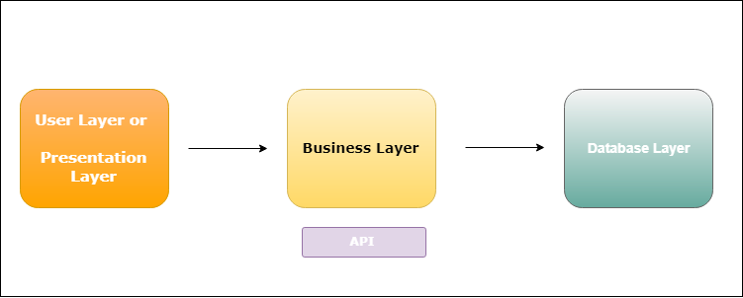
API Explained - In WebApp

Slide 7
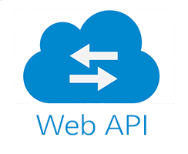
Type of API
We are only Concern about the Web API Simple Object Access Protocol Remote Procedure Call Representational State Transfer (REST).
etc…..
SOAP
RPC
REST

Slide 8


What is REST ?

Slide 9
Let’s Understand - REST API
REST Explained
REST is the underlying architectural principle of the web. The amazing thing about the web is the fact that clients (browsers) and servers can interact in complex ways without the client knowing anything beforehand about the server and the resources it hosts. The key constraint is that the server and client must both agree on the media used, which in the case of the web is HTML. There are six constraints to for any API to be REST API.

Slide 10


Let’s Understand - REST API
REST Explained
Uniform Interface - As Resource-Based - Type HTML, XML, JSON with UTF-8 are supported.
- Manipulation of Resources Through Representations -- Client holds a representation of a resource to manipulate the server resources.
- Self-descriptive Messages -- Message should describe the MIME type, Parsing info.
- Hypermedia as the Engine of Application State (HATEOAS) - Clients deliver state via body contents, query-string parameters, request headers and the requested URI (the resource name).

Slide 11

Who Uses REST
Twitter API
LinkedIn API
Slack API
…… many more…...

Slide 12
Let’s Understand - HTTP first.

Slide 13
Let’s Understand - HyperText Transfer Protocol(HTTP)
HTTP (Hypertext Transfer Protocol) is perhaps the most popular application protocol used in the Internet (or The WEB).
An HTTP client sends a request message to an HTTP server. The server, in turn, returns a response message. In other words, HTTP is a pull protocol, the client pulls information from the server (instead of server pushes information down to the client).
HTTP is a stateless protocol. In other words, the current request does not know what has been done in the previous requests.
HTTP permits negotiating of data type and representation, so as to allow systems to be built independently of the data being transferred.

Slide 14
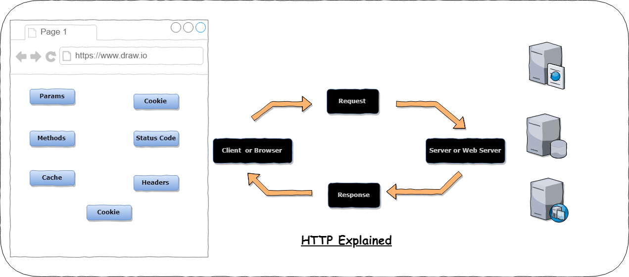

Slide 15
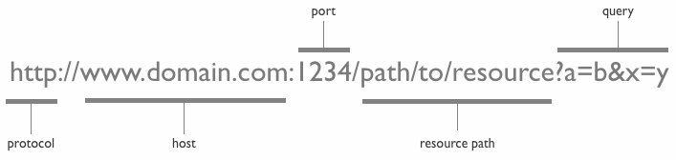
Understanding HTTP -

Slide 16

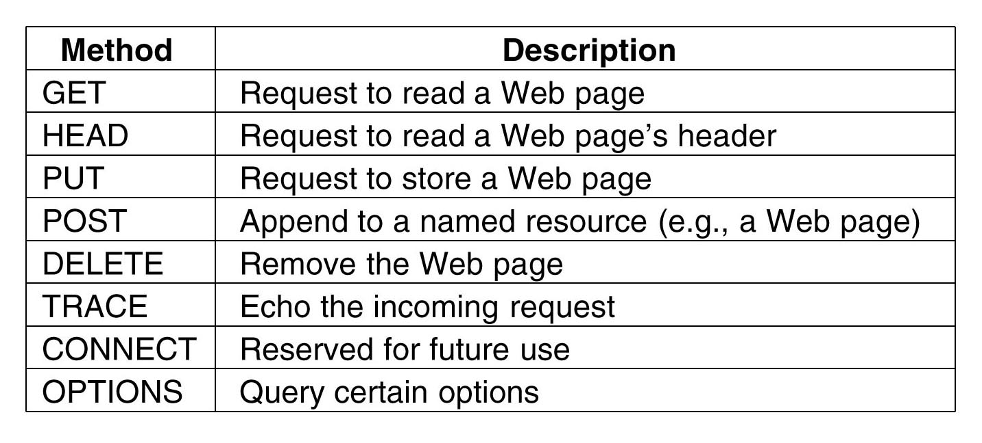
HTTP Methods

Slide 17


HTTP Status Codes
HTTP
1xx: Informational Messages
2xx: Successful 3xx: Redirection 4xx: Client Error 5xx: Server Error

Slide 18
How to view HTTP Traffic?

Slide 19
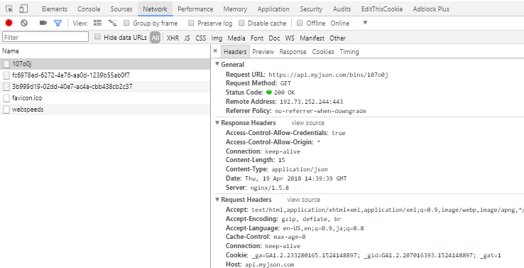
HTTP Traffic View in Dev Tool Chrome
Tools to View HTTP Traffic Go to - https://api.myjson.com/bins/107o0j
F12 key in Windows To open Dev Tools
Undoubtedly, the Chrome/Webkit inspector is a favorite amongst web developers

Slide 20


Demo - Lets Open Chrome

Slide 21

What is Authentication?

Slide 22
What is Web-Authentication ?
Authentication is a process in which the credentials provided are compared to those on file in a database of authorized users' information on a local operating system or within an authentication server. HTTP Basic authentication : - Based on a username and password, is the authentication mechanism defined in the HTTP/1.0 specification. base64 encoding is used. E.g E.g user named john with password secret - am9objpzZWNyZXQ= curl --header "Authorization: Basic am9objpzZWNyZXQ=" my-website.com
username:password
User
Server
user authenticated

Slide 23
What is Authentication ?
HTTP Digest Authentication. - Authentication is performed by transmitting the password in an ENCRYPTED form which is much MORE SECURE than the simple base64 encoding used by Basic Authentication Form Based Authentication - The login form must contain fields for entering a username and a password. <form method='post' action='j_security_check'> <input type='text' name='j_username'> <input type='password' name='j_password'> </form>

Slide 24
What is Cookie & Token(In HTTP)?

Slide 25
Cookie & Tokens basics
Cookies : When a server receives an HTTP request in the response, it can send a Set-Cookie header. The browser puts it into a cookie jar, and the cookie will be sent along with every request made to the same origin in the Cookie HTTP header. You can use cookies for authentication purposes but they have incompatibility with REST - as it introduces a state into a stateless protocol But most widely used are Tokens (In REST APIs) Tokens : Sometimes called Json web token, Some kind of unique string that can identify the client and its permission level. -

Slide 26


Lets move to next tutorial...

